Slide 1
Project Management Tools for Making it Real

Slide 2
VCU Technology Services
Planning and Project Management Office
3 Project Managers - Sean Mays, Mark Covington, Craig Kilgo
Outside standard hierarchical org chart
Provide project management consultation inside and outside Technology Services
Supports the project management information system of record for the university.

Slide 3
The Problem
Our project management information system needed to change.

Slide 4
Why?
General disuse plus the lack of data among the small population of users meant that it was useless for leadership.
Our new VP of Administration wanted better insight into projects.
CIO authorized complete PMIT overhaul / replacement.

Slide 5
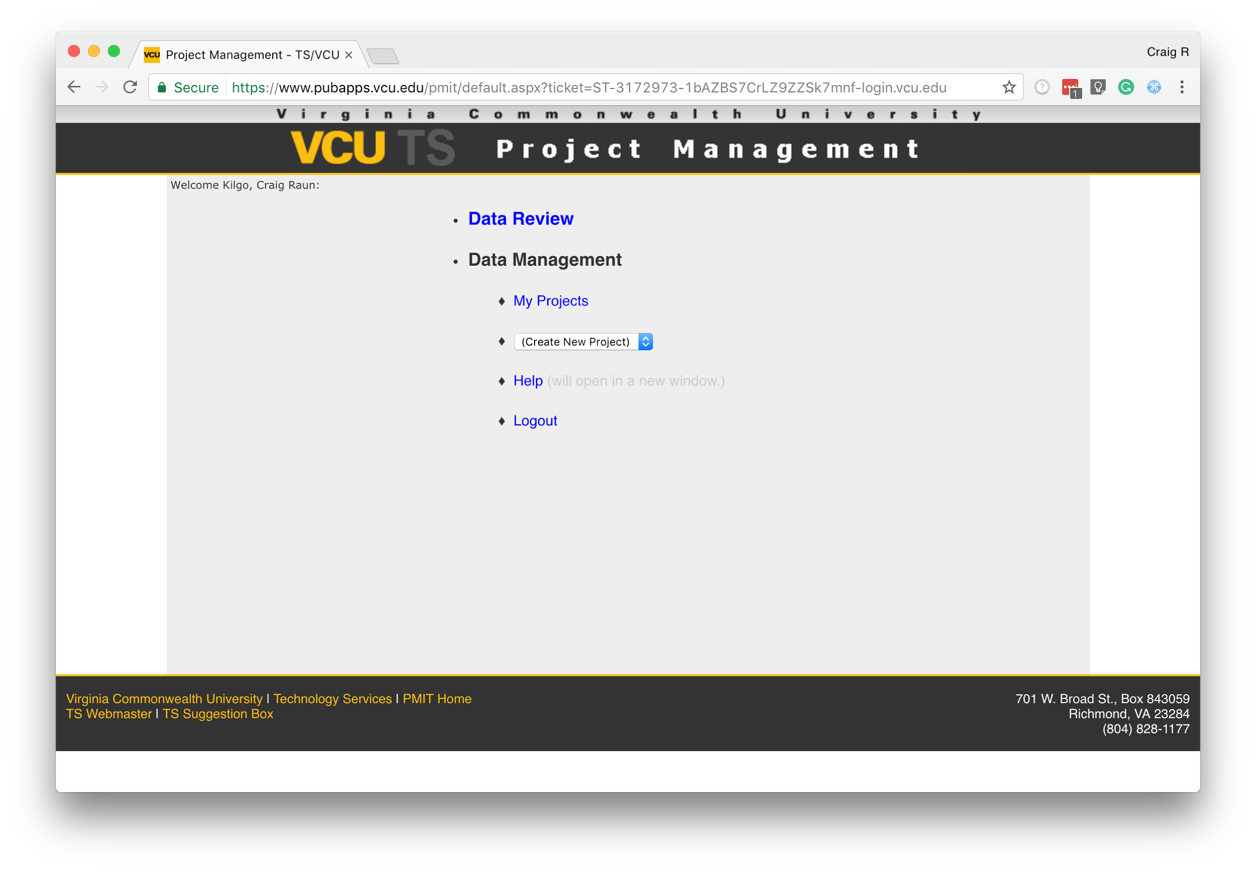
The Old System
PMIT
Developed in-house by a .Net developer working with our previous PPMO Director in 2009
Low on usability
High levels of friction to get data in
Reporting functions were detached from the application
Inflexible model for how projects should be run

Slide 6
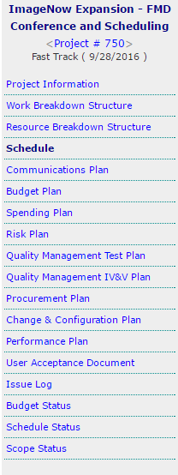
The Old System
Comprehensive scope of necessary input.

Slide 7
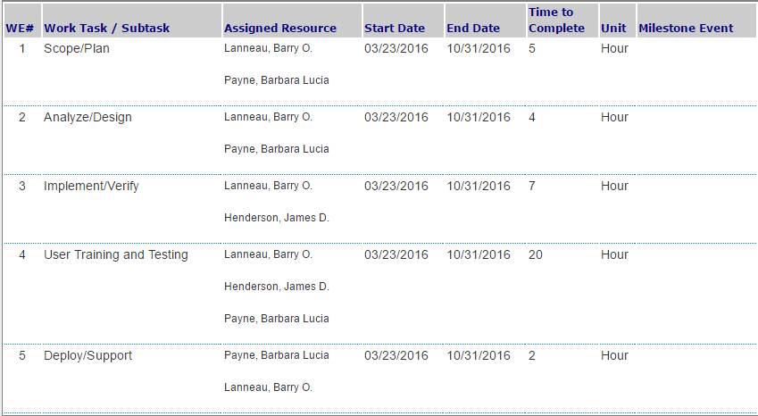
The Old System
Forced each project manager to input high level data.

Slide 8
Media Support Services and Records and Registration had recommended Smartsheet.
VP of Administration and Dr. Rao blessed this as a tool which they thought should go forth.
They also expressed a desire to start seeing Gantt charts for ongoing projects.

Slide 9
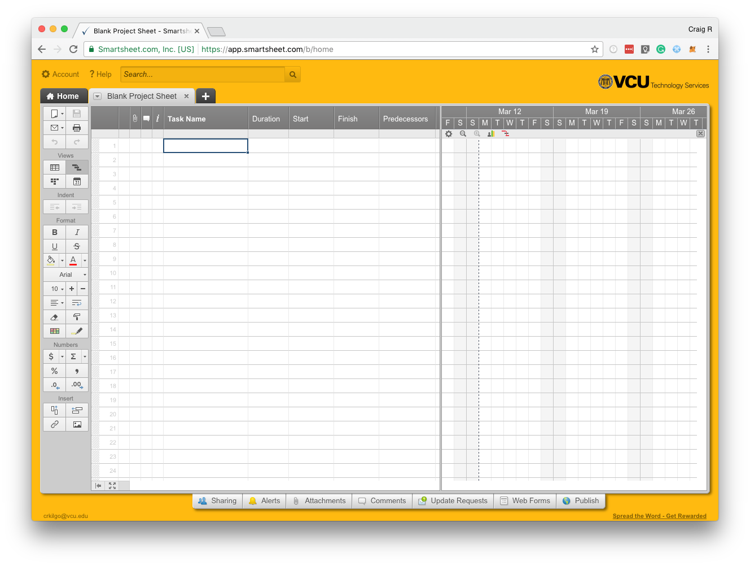
Smartsheet
Project Sheet
Smartsheet Project Sheet looks similar to a stripped down version of Microsoft Project.

Slide 10
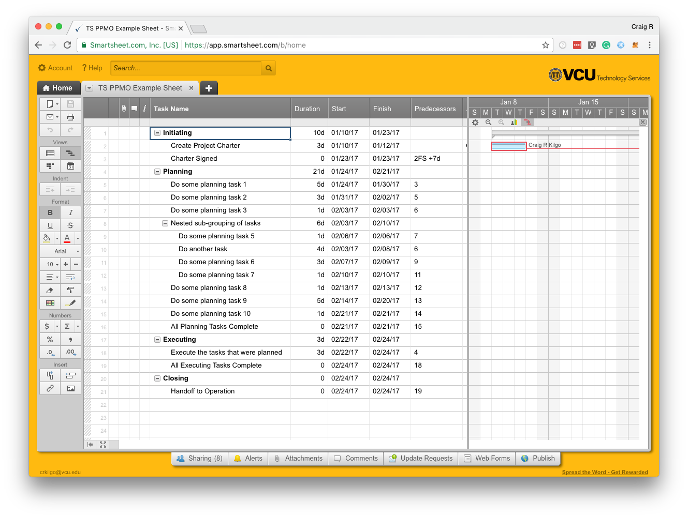
Smartsheet
Project Sheet
Autopopulates a Gantt Chart which can calculate Critical Path.

Slide 11
Now we have schedules, what next?

Slide 12
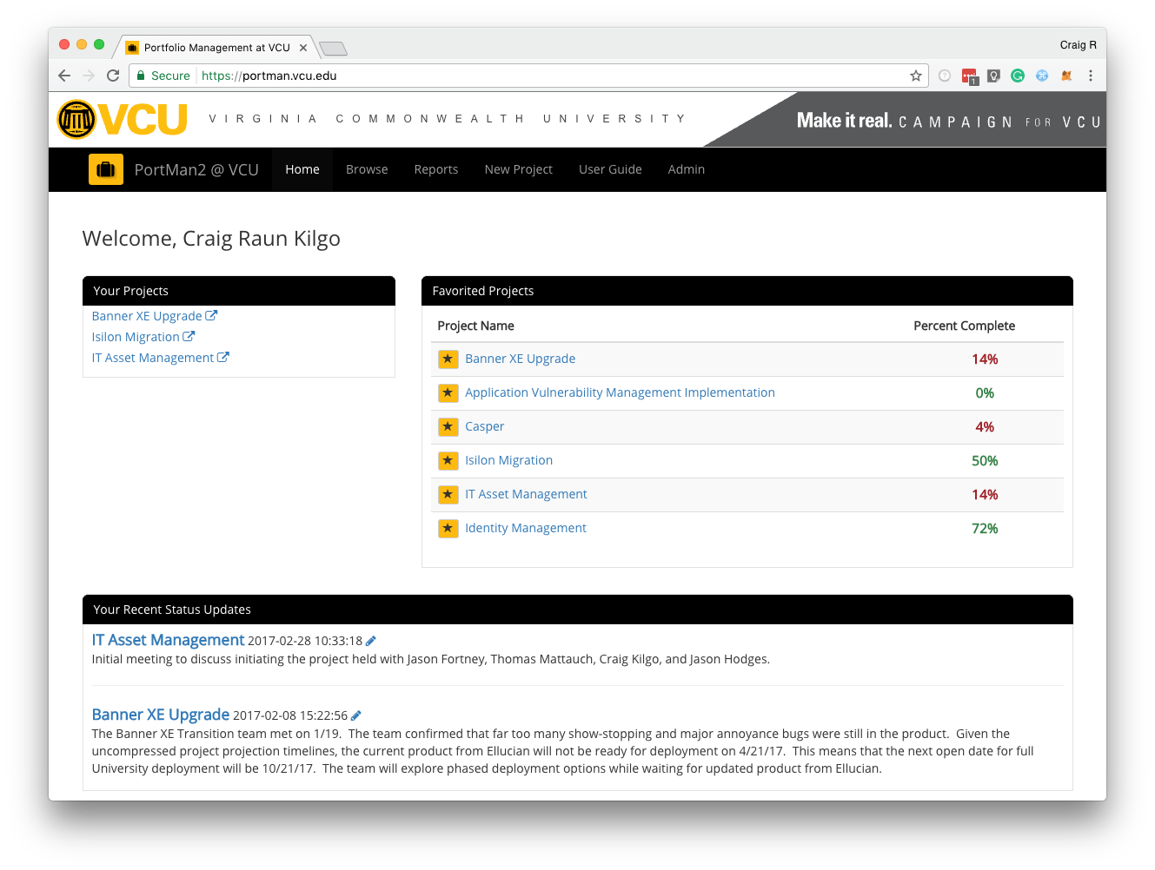
VCU PortMan
(Portfolio Manager)
Goals:
Create aggregated place of schedule data
Create repository for other project information
Provide avenues for leadership reporting
Ease input of project data
Create a scalable and flexible portfolio management system
Create avenue to drive best practice adoption

Slide 13
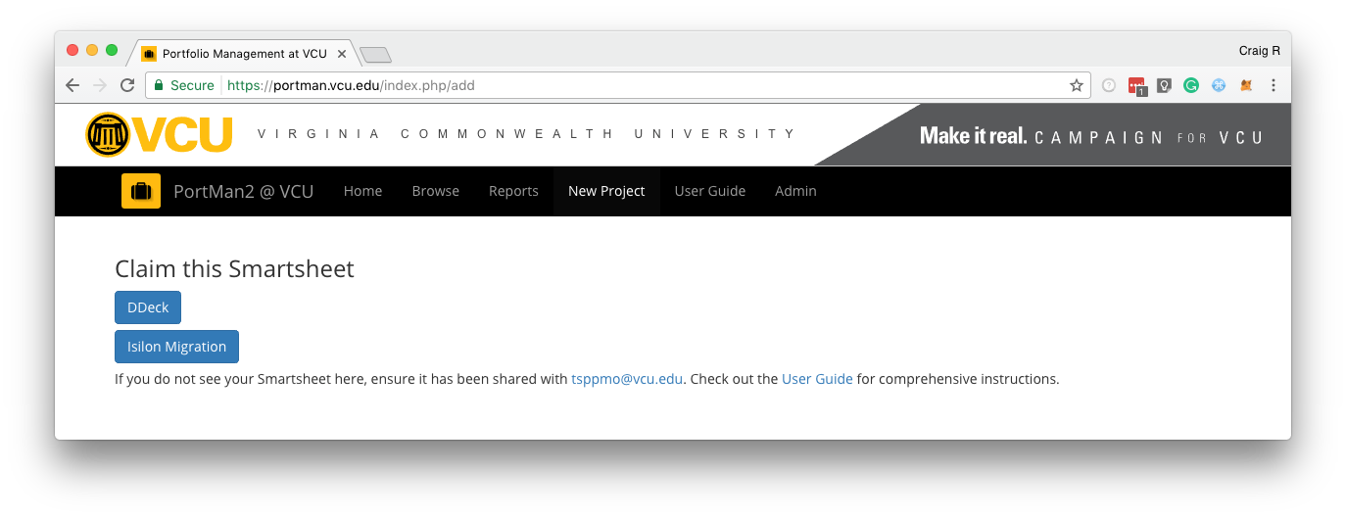
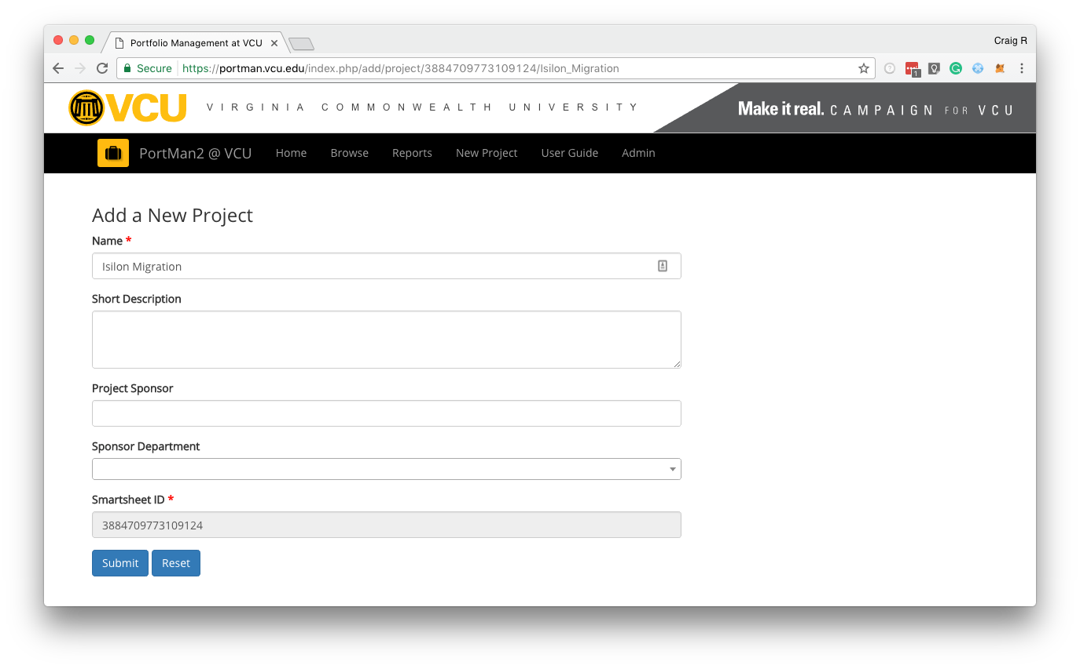
VCU PortMan
(Portfolio Manager)
Adding a project takes just 3 clicks and 3 pieces of data to get started.
Everything on the dashboard (except for Status Updates) populates from the Smartsheet.

Slide 14
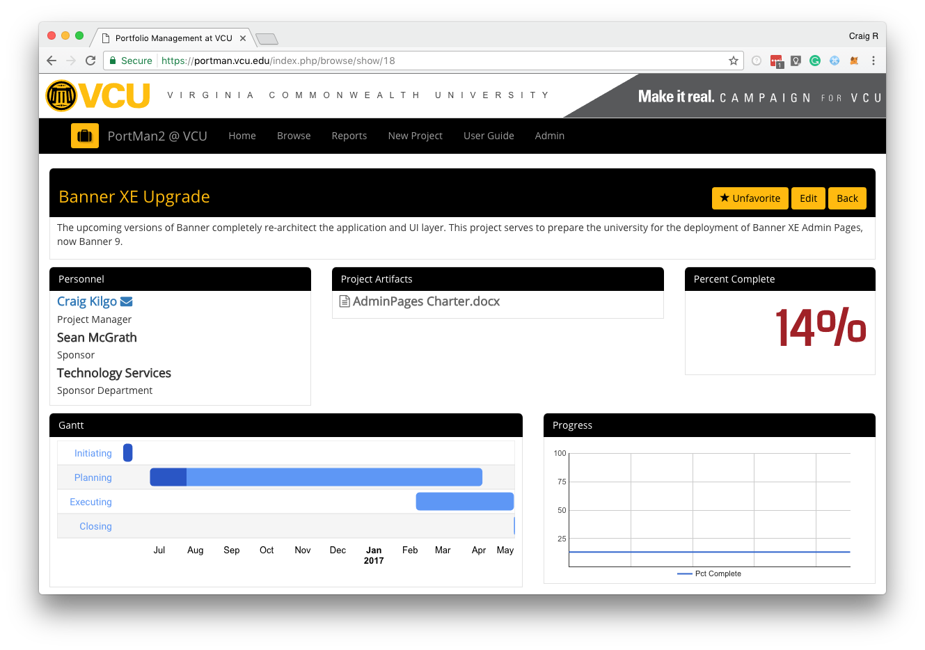
VCU PortMan
(Portfolio Manager)
Each project gets its own dashboard
Big colored percentage number was the number one feature request
Followed closely by “Gantt charts”

Slide 15
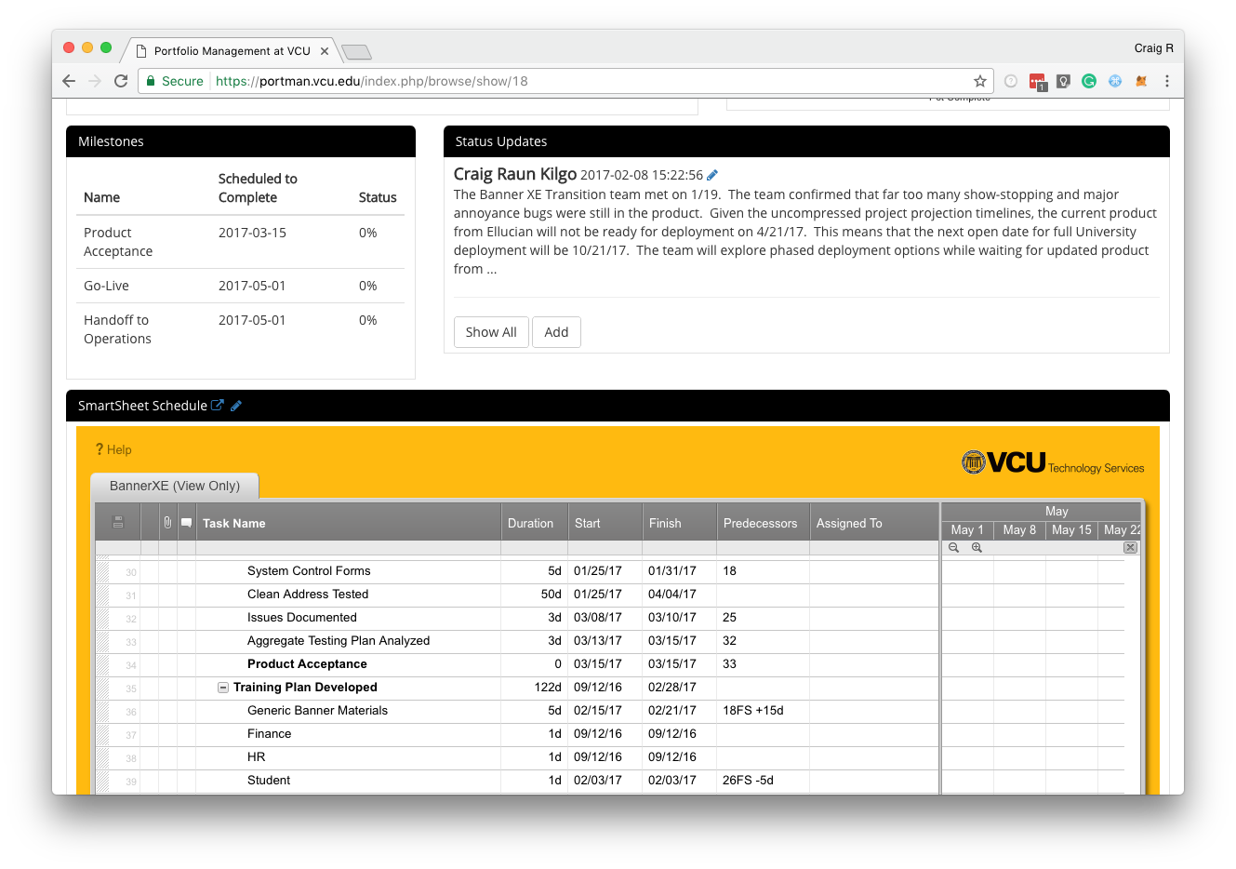
VCU PortMan
(Portfolio Manager)
The actual Smartsheet is also embedded in a view-only mode
Status updates were added to allow for qualitative information

Slide 16
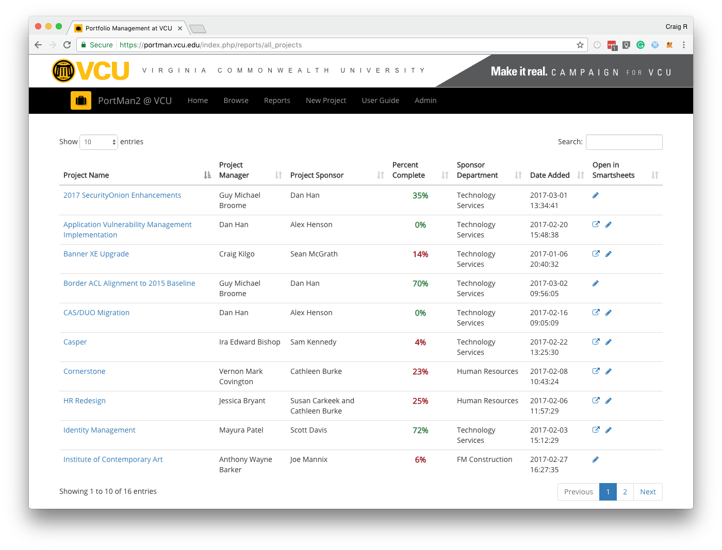
VCU PortMan
(Portfolio Manager)
The “All Projects” report was the most requested report.
Leadership simply wanted a quick view of projects, how far along they are and if they are on-schedule.

Slide 17
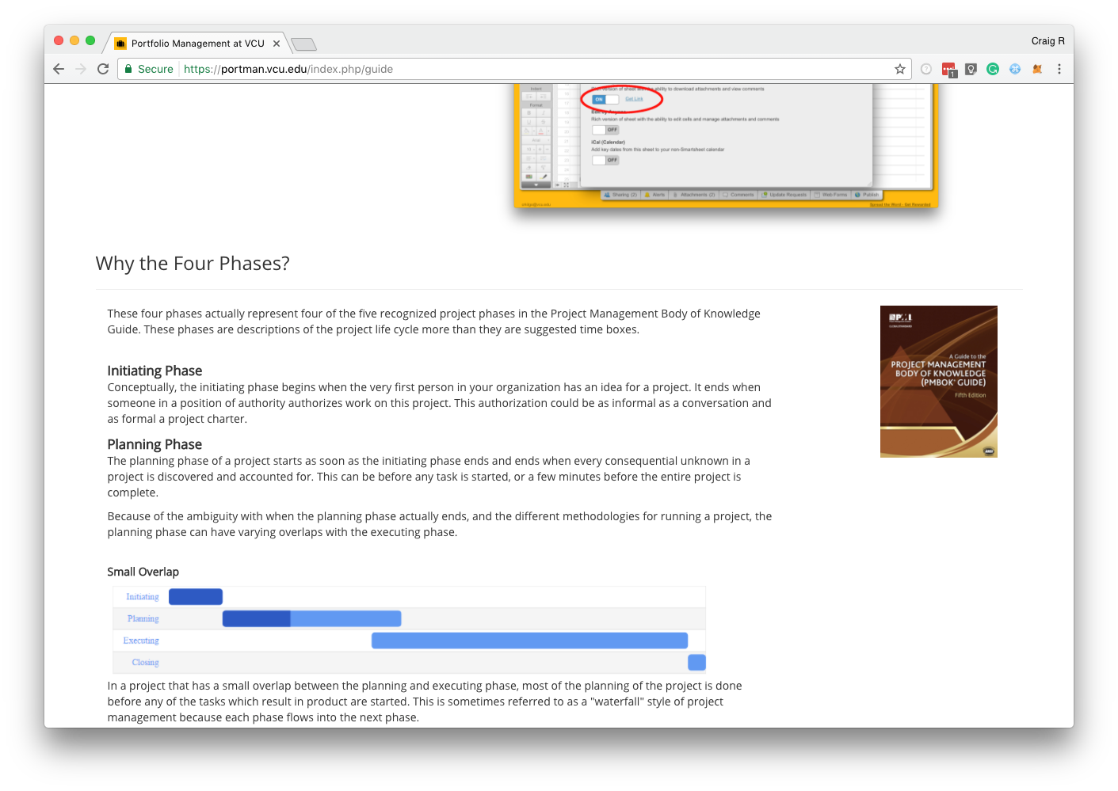
VCU PortMan
(Portfolio Manager)
Integrated user guide explains not only the application, but the project management principles behind the functions
Longterm plan to continue to push best practices as the community matures

Slide 18
Results so far
Started beta/pilot phase at the end of February
PPMO Project Managers
Cybersecurity
Currently 16 projects are being tracked
12 projects were entered into PMIT in all of 2016
Excellent feedback from leadership so far:
CIO
VP of Administration
Chief of Police

